Slide 1

SENTIMENT ANALYSIS
On
IPHONE 4S REVIEW
Group : 5
Mentor :Neha Ramchandani, Himavanth

Slide 2

Team Members
Akash Sapariya
Akshaya
Amrutha Kakkoth
Dalmiya Candace Denzil
Raju M C
Snehal Ghodake
Sucheta Nagesh Angadi

Slide 3
Business Objective
The main objective of this project work is to perform the sentimental analysis on the product feature - Siri, on Iphone 4S.
This was done by applying the NLP process on over 27 thousand reviews extracted from different sources.

Slide 4
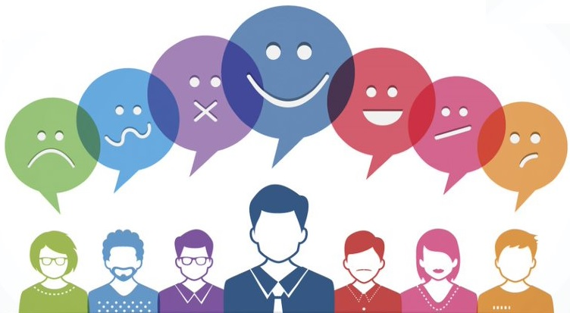
Sentiment analysis
Sentiment analysis is a natural language processing (NLP) technique used to determine whether data is positive, negative or neutral. Sentiment analysis is often performed on textual data to help businesses monitor brand and product sentiment in customer feedback, and understand customer needs.

Slide 5
Project Flow
Data Collection/Gathering
Text Preprocessing / text cleaning
Sentimental Analysis
EDA
Feature Generation
Partition Series
Model Building
Evaluate & Compare Performance
Deployment

Slide 6

Data Collection
Data was extracted using web scraping method from different E-commerce websites such as Flipkart, Amazon, E-bay , GSM Arena etc.
We have collected ~ 27K data.

Slide 7
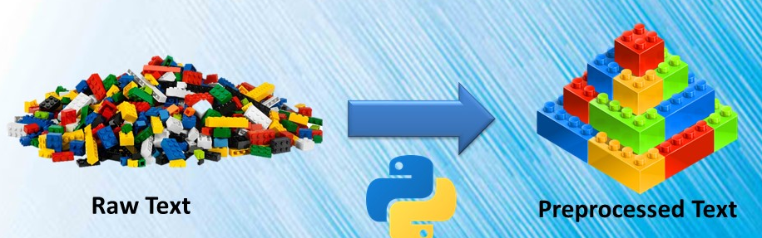
Text Preprocessing / text cleaning
Steps in text cleaning:
Noise entity removal
Convert to lowercase
Remove punctuations, Stopwords , hyperlinks ,HTML tags , Numericals, Quotes, whitespaces,Non alpha characters.
Text Normalization
Stemming / lemmatization
Tokenization

Slide 8
Sentiment Analysis
Methods used to do sentiment analysis:
Textblob -
VADER lexicon
Afinn lexicon
Workflow to analysis the sentiment in the review
Subjectivity and Polarity of the review was calculated.
Sentiment score such as positivity, neutral and negativity was calculated from polarity.
Label encoding was used to convert the sentiment score (text) to numerical.
Atlast, the total count of each sentiment generated from review was calculated.
Notes:
Text Blob:
Sentiment analyzer returns two properties for a given input sentence:
Polarity is a float that lies between [-1,1], -1 indicates negative sentiment and +1 indicates positive sentiments.
Subjectivity is also a float that lies in the range of [0,1]. Subjective sentences generally refer to opinion, emotion, or judgment.
Vadar:
It uses a list of lexical features (e.g. word) which are labeled as positive or negative according to their semantic orientation to calculate the text sentiment. Vader sentiment returns the probability of a given input sentence to be positive, negative, and neutral.

Slide 9
 | TextBlob/Vader | Afinn
Positivity score | 17316 | 15847
Neutral score | 6729 | 7651
Negative score | 3423 | 3970

Slide 10
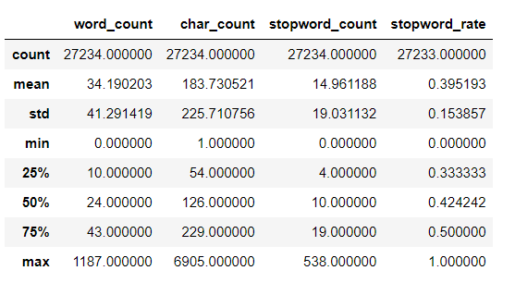
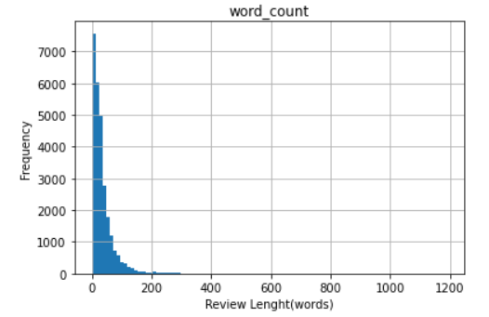
EDA
We can see that the number of words per user review is highly positive skewed with a mean of 34, which means that an average, user review have 34 words.

Slide 11
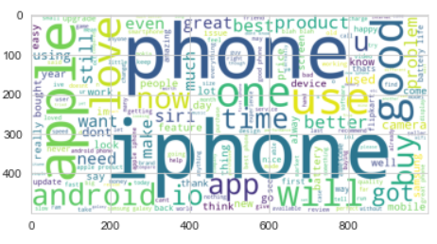
Word Cloud

Slide 12
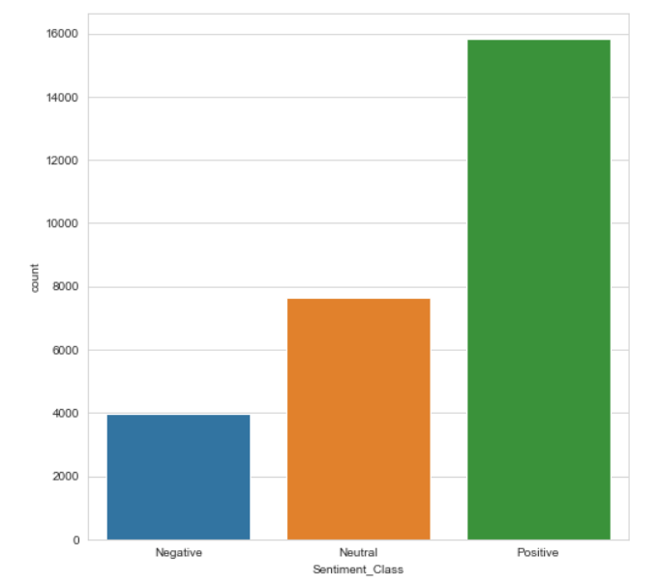
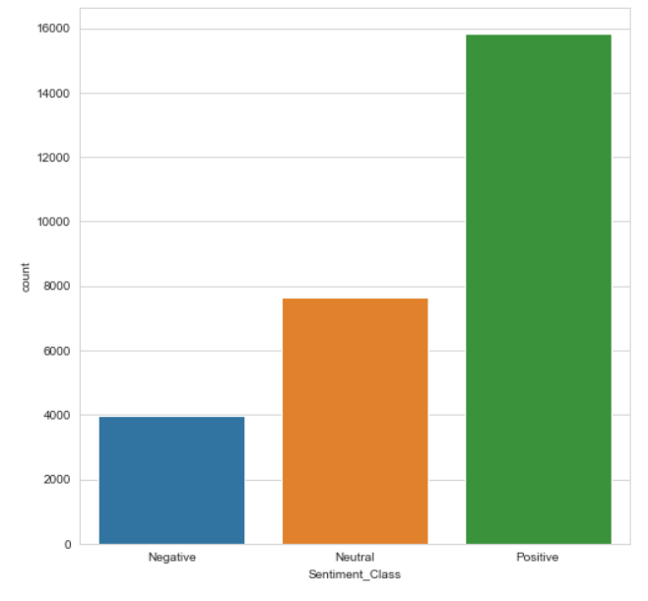
Sentimental Analysis - Bar Graph
Text Blob
Afinn

Slide 13
Feature Generation
Conversion of Text to Vector Format
TFIDF - Term frequency–Inverse document frequency
Assigns weight to each word based on its term frequency(tf) and the reciprocal document frequency(idf).

Slide 14
Splitting the data into test and train
The final data after data processing was split into test data and train data
 | X | Y
Train Set | 21974, 100 | 21974, 1
Test Set | 5494, 100 | 5494, 1

Slide 15
Model Building
Models | Accuracy(Textblob) | Accuracy(Vader lexicon)
Decision tree(gini) | 72.06 | 72.69
Logistic regression | 75.15 | 74.97
Random forest | 72.24 | 72.69
Naive bayes | 66.82 | 66.8
Multinomial naive bayes | 61.62 | 61.82

Slide 16
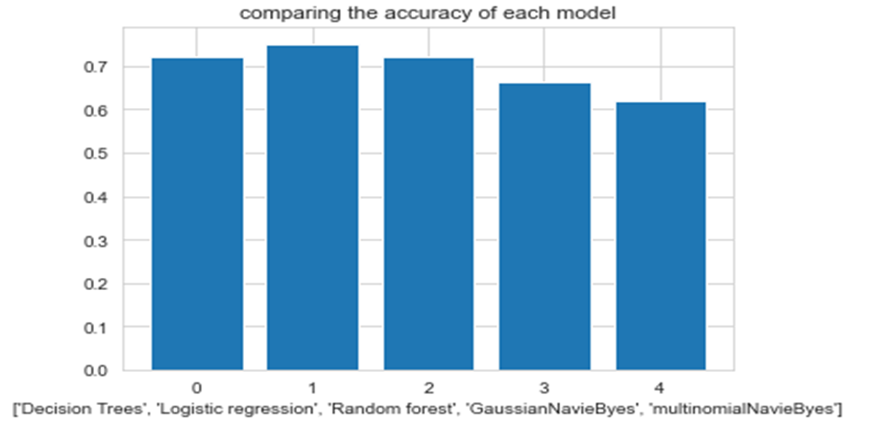
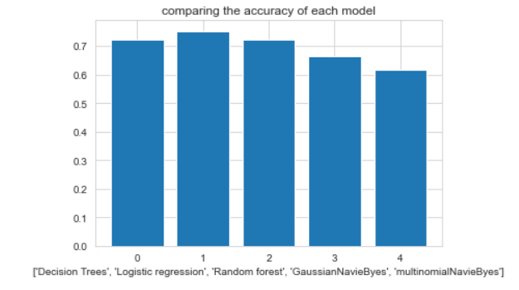
Comparison
Comparison of Algorithm Accuracy using textblob
Comparison of Algorithm Accuracy using Vader

Slide 17
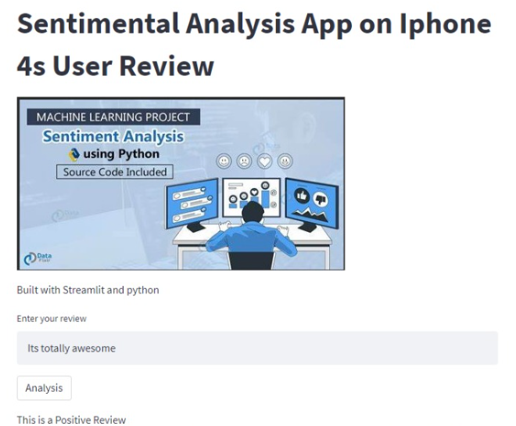
Deployment Using Streamlit

Slide 18
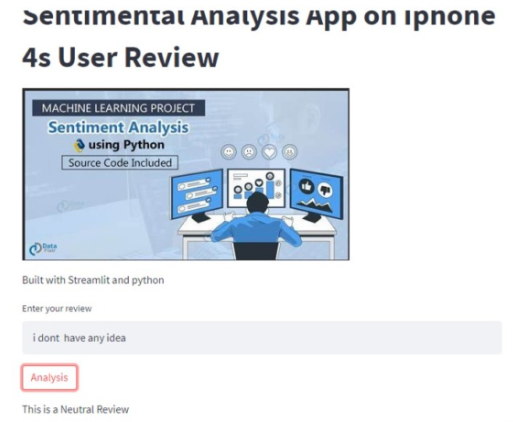

Slide 19
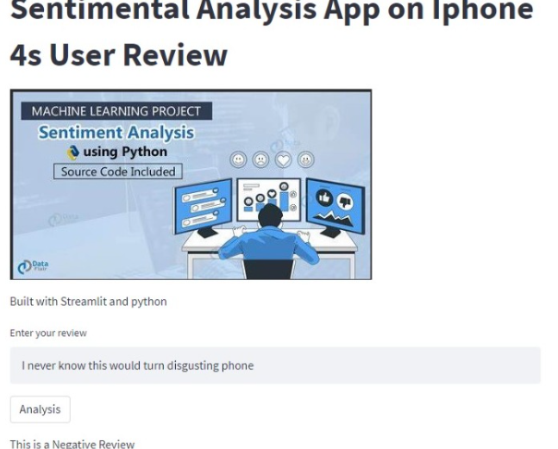

Slide 20
CHALLENGES FACED
Web Scraping
Deployment
CHALLENGES
Model Building
Analysis score detection

Slide 21
Best Positive reviews
Summary
Hi friends with my personnel experience about iPhone 4s, the 4s is looking good and camera quality is very nice because it does non breakable images when will zoom in. about battery life it is normal, touch and display very superb because I had an experience, it less than better with iphone 5s, the iphone 4s is good I ever seen like this phone because its not normal phone it had so many features,
Worst Negative reviews
Hi Apple Dumb. Shame on you. Please see facts from wikipedia who is the ugly copycat in th first place and need to pay Nokia damage and settle outside courts. you all can brag about innovation. But its all shit bcos wikipedia dun lie.

Slide 22
THANK YOU

